Slide 1


Studying the Impact of Code Deobfuscation on obfuscated Android Piggyback App For Detection
Yanxin Zhang
School of Computer Science
Faculty of Engineering and IT

Slide 2
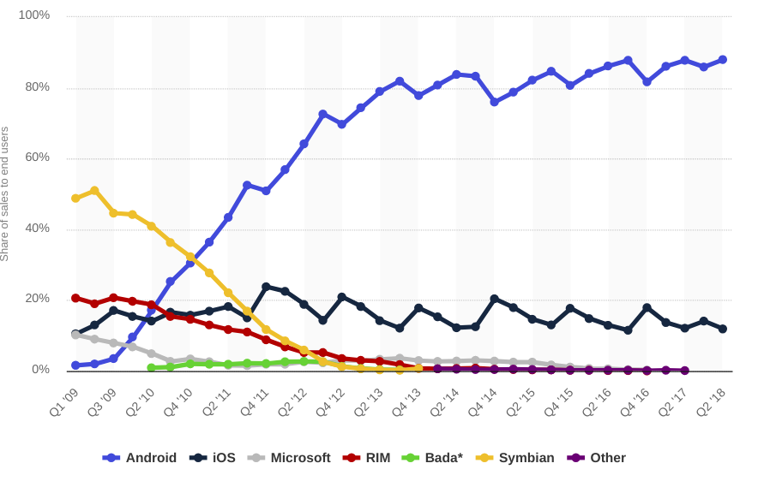
Background – Android OS

Slide 3
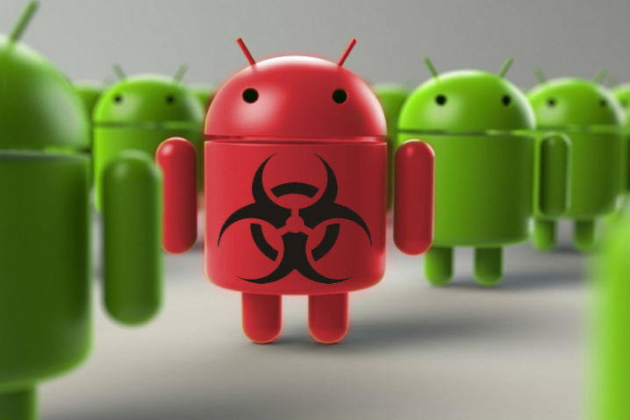
Background – Android OS

Slide 4
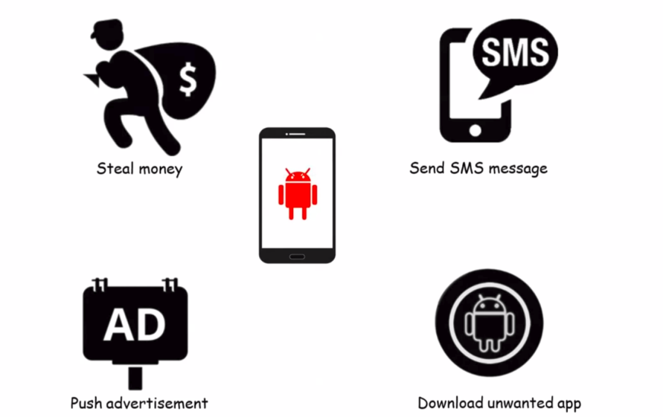
Background – Android OS

Slide 5
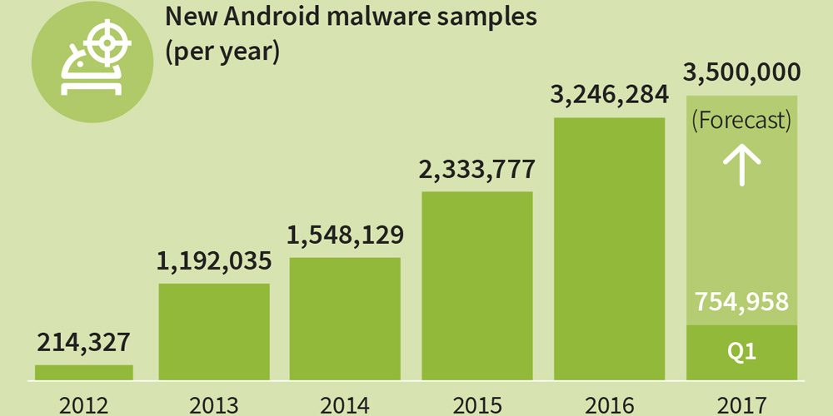
Background – Android OS

Slide 6
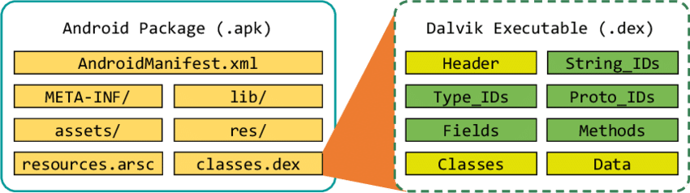
Background – Android malware

Slide 7
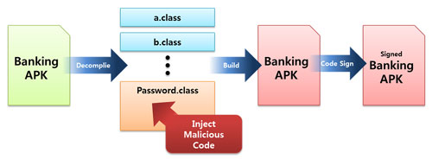
Background – Piggybacked Android Malware

Slide 8
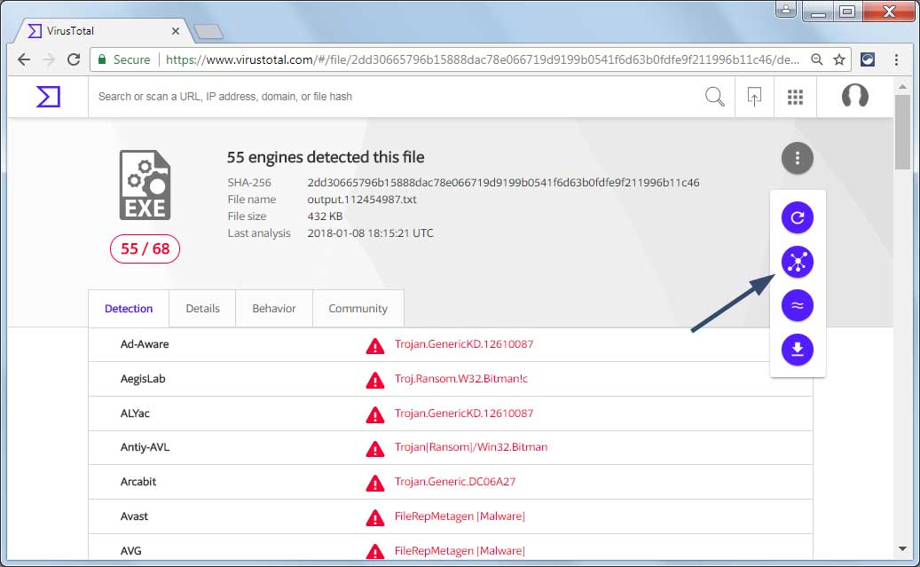
Background – Virustotal

Slide 9
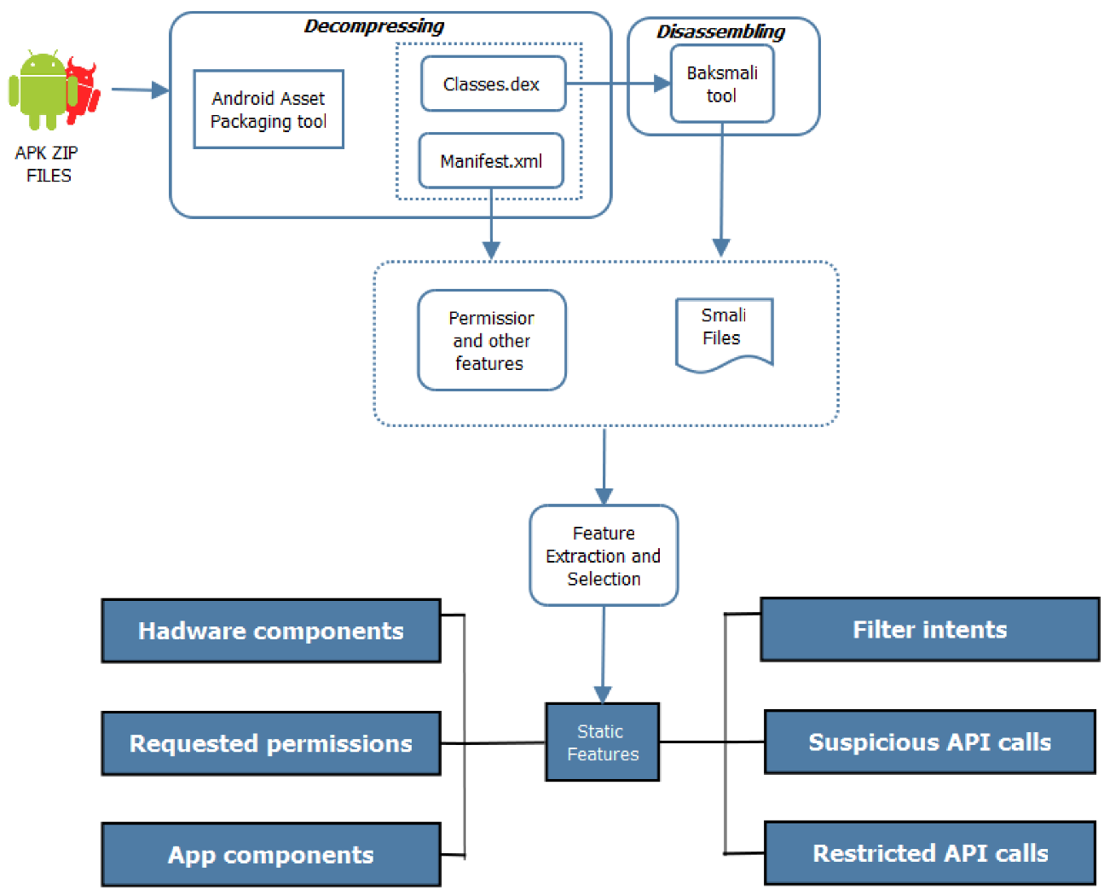
Background – Machine learning detection

Slide 10
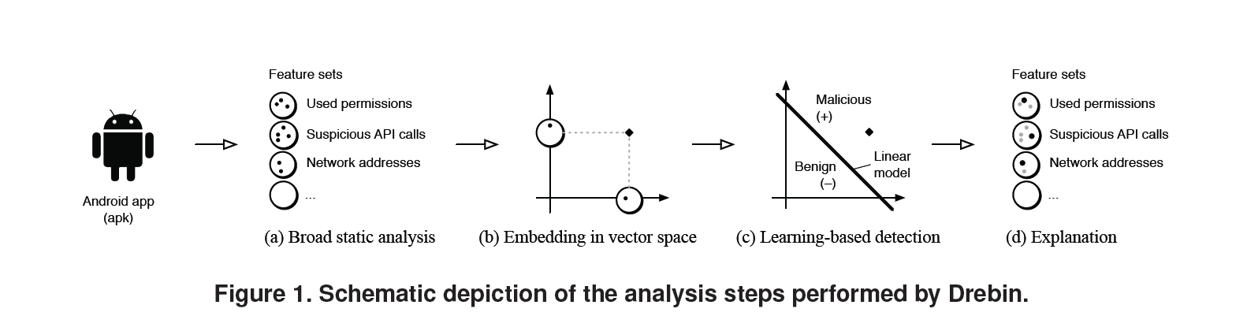
Background – Machine learning detection - Drebin

Slide 11
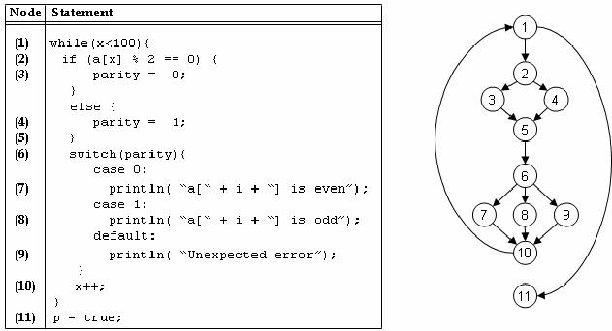
Background – Machine learning detection - CSBD

Slide 12
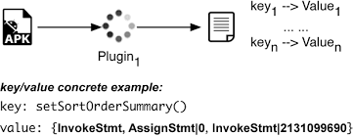
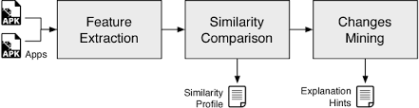
Background – Similarity based detector –
Androguard & Simidroid

Slide 13
Background - Obfuscation
Transforming a code into a form that is more difficult for humans, and possibly machines, to read, understand, and reverse engineer.
These transformations change the syntax of code but not their semantics.

Slide 14
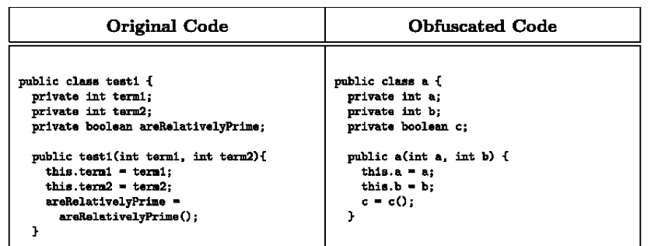
Background - Obfuscation

Slide 15
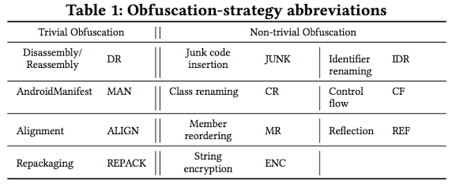
Background - Obfuscation

Slide 16
Research Questions
2018 – ICSE(A+) - A Large-Scale Empirical Study on the Effects of Code Obfuscations on Android Apps and Anti-Malware Products
2018 - ACSAC(A+) - A Large Scale Investigation of Obfuscation Use in Google Play
2019 - TIFS(A+) - Android HIV: A Study of Repackaging Malware for Evading Machine-Learning Detection

Slide 17

Background - Deobfuscation

Slide 18
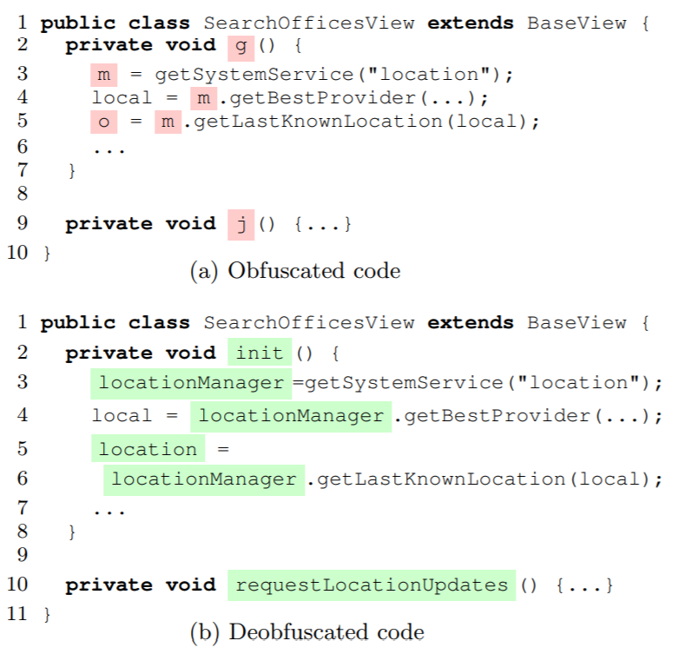
Background - Deobfuscation

Slide 19
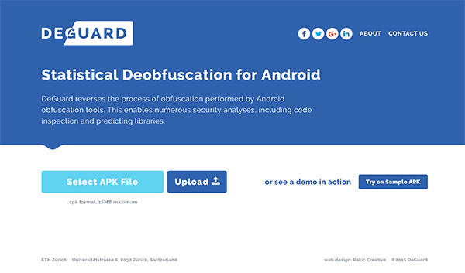
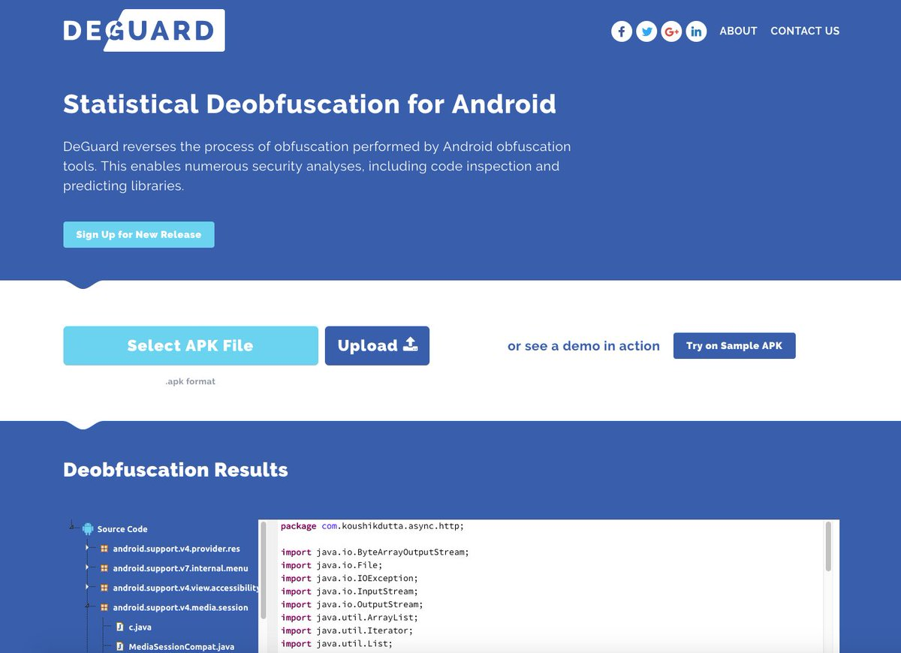
2016 - CCS(A+) - Deguard

Slide 20
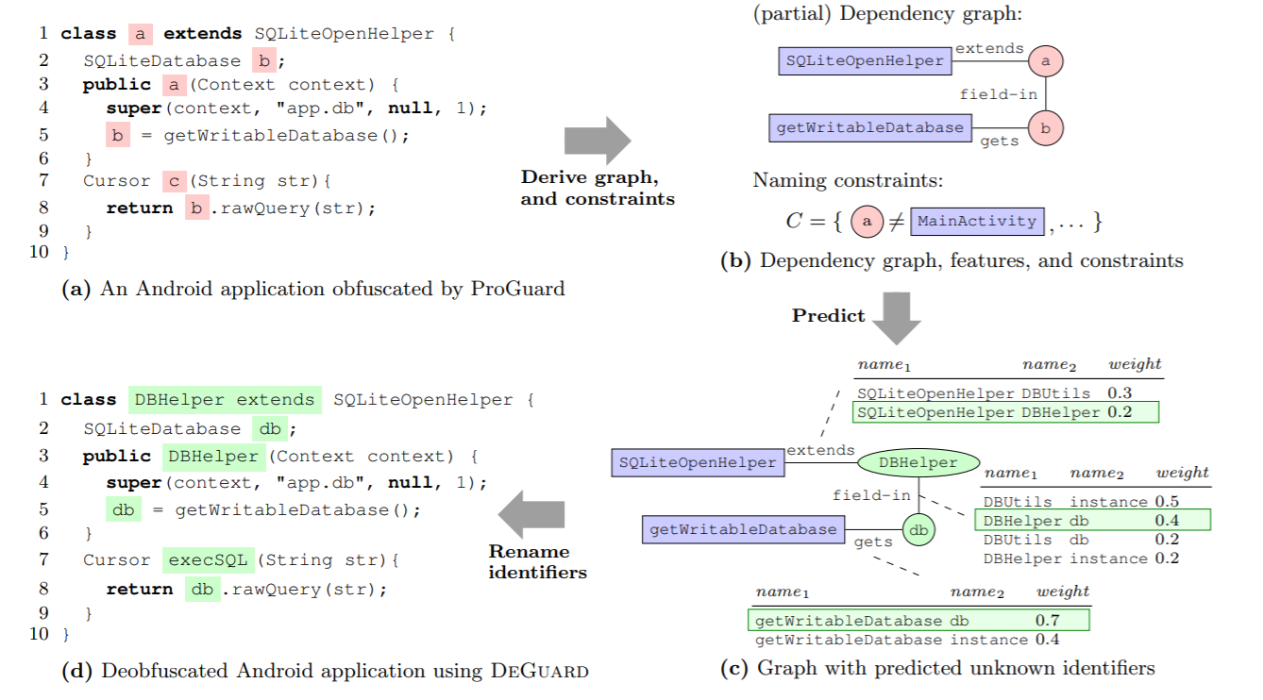
DeGuard

Slide 21
Simplify
Smalivm : Provides a virtual machine sandbox for executing Dalvik methods. After executing a method, it returns a graph containing all possible register and class values for every execution path.
Simplify : Analyzes the execution graphs from smalivm and applies optimizations such as constant propagation, dead code removal, unreflection, and some peephole optimizations.

Slide 22
Research Questions
1. How is the accuracy of all types of detectors affected by obfuscation?
2. How is the accuracy of commercial anti-malware products affected by deobfuscation?
3. How is the accuracy of machine learning guided detector affected by deobfuscation?
4. How is the accuracy of similarity based detectors affected by deobfuscation?

Slide 23
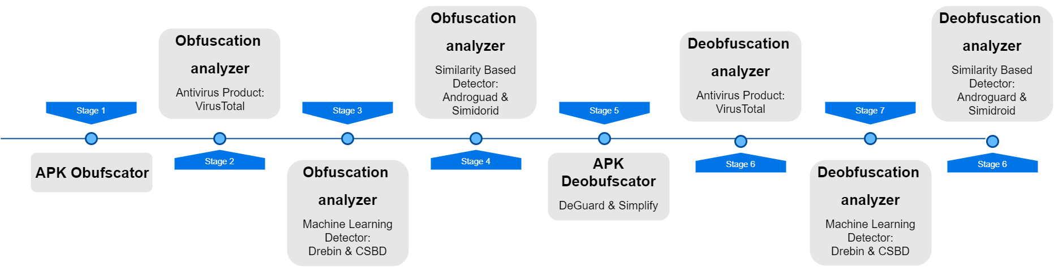
Methodology – Framework

Slide 24
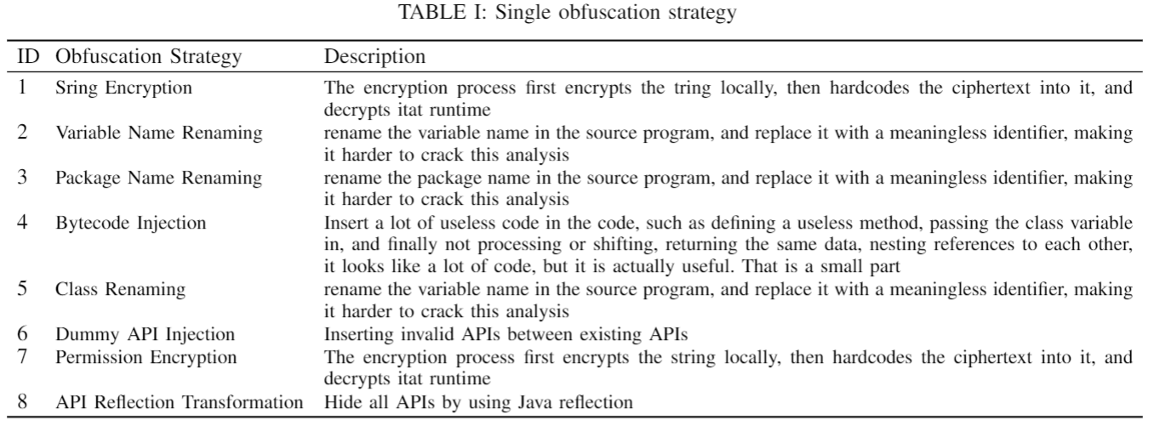
Methodology – obfuscation strategy

Slide 25
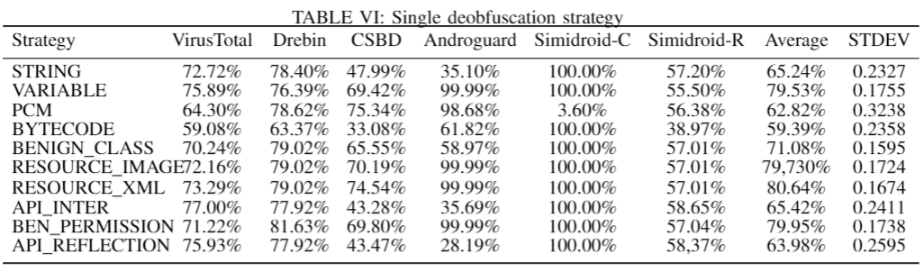
Experiments - Obfuscation

Slide 26
Experiments - Virustotal

Slide 27
Experiments - Drebin

Slide 28
Experiments - CSBD

Slide 29
Experiments – Simidroid – Component

Slide 30
Experiments – Simidroid – Resource

Slide 31
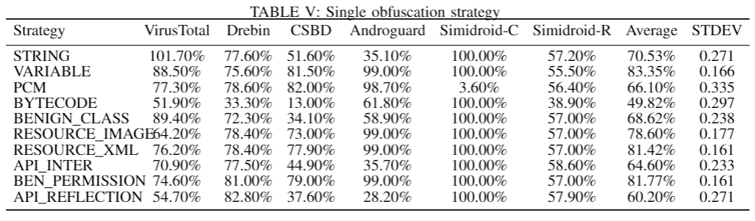
Experiments – Deobfuscation - Simplify

Slide 32
Compare - Virustotal

Slide 33
Compare - Drebin

Slide 34
Compare - CSBD

Slide 35
Compare – Androguard

Slide 36
Compare – Simidroid-Com

Slide 37
Compare – Simidroid-Resource

Slide 38
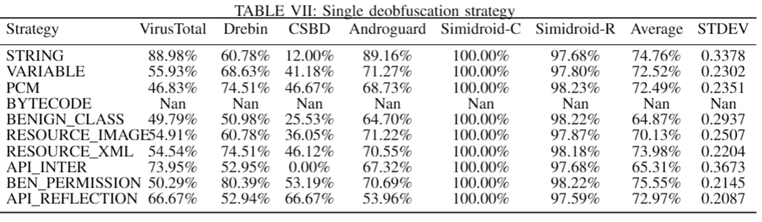
Experiments – Deobfuscation - Deguard

Slide 39
Deguard - Virustotal

Slide 40
Deguard – Drebin

Slide 41
Deguard - CSBD

Slide 42
Deguard – Androguard

Slide 43
Deguard – Simidroid-Com

Slide 44
Deguard – Simidroid-Resource

Slide 45

Thanks For Your Listening

